Slide 1
Welcome to My Presentation

Slide 2
Shama Rani Karmakar
Roll No: 01-029-18
Course Title: Computer Fundamental and Office Application
Session: 2022-23 ( AS: 2020-21)
Department of Biochemistry & Biotechnology
University of Barishal

Slide 3
Presentation Topic:
Ratio Analysis of Safko Spinning Mills Limited

Slide 4
Ratio Analysis
Ratio analysis can mark how a company is performing over time, while comparing a company to another within the same industry or sector. Investor can use ratio analysis to compare companies.

Slide 5
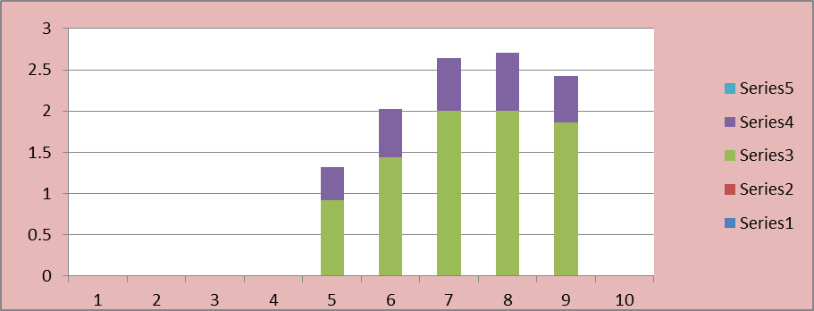
Liquidity Ratio

Slide 6
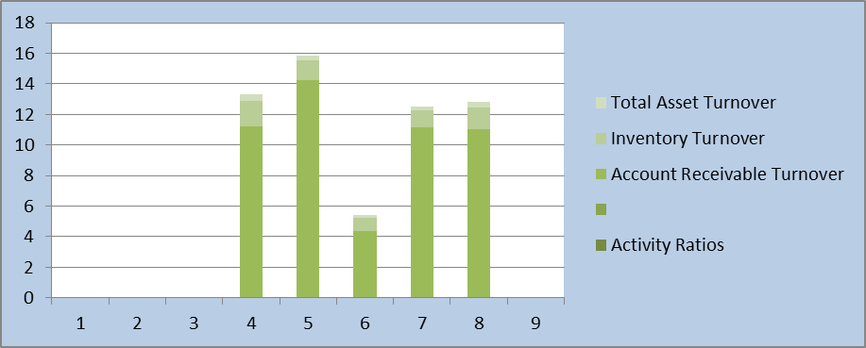
Activity Ratio

Slide 7
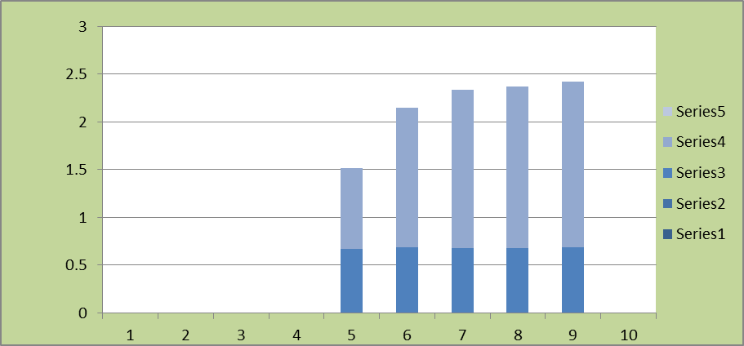
Debt Ratio

Slide 8
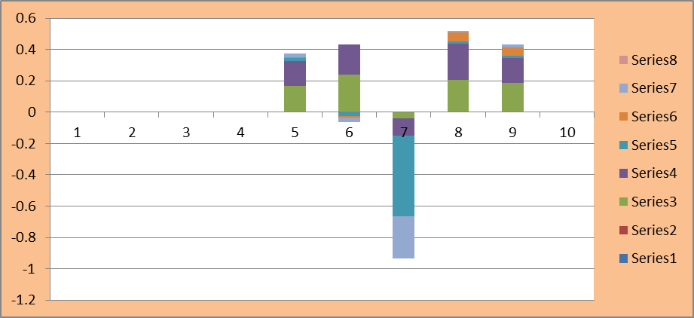
Profitability Ratio

Slide 9
Conclusion
In Liquidity Ratio, the average current ratio of five years are 1.64 which indicate a company is able to pay its current debts as they come due. On the other hand all Quick Ratios are below 1 which is not good for the company .In Activity Ratio all inventory turnover ratio is below 2 and 4 which is not good for a company. The Total Asset Turnover is below 1. So, it is not good for the company. In Debt Ratio is lower than 1 which means the company has more assets than debt. In 2018, 2019 and 2020 the ROA is not perform well but in 2021 and 2022 the percentage is increase. ROE is below 5% which would be considered low.

Slide 10


